Slide 1

Assignment 3, 4 and 5
Generate SliderPlus Puzzles in PPT
Siva R Jasthi
ICS499 Software Engineering and Capstone Project
Spring 2022
Computer Science and Cyber Security
Metropolitan State University

Slide 2
Assignment 3,4 and 5 Goals
We will explore Web Services.
https://indic-wp.thisisjava.com/docs/api.php
We will develop puzzles (Slider 15) using those Web Services

Slide 3
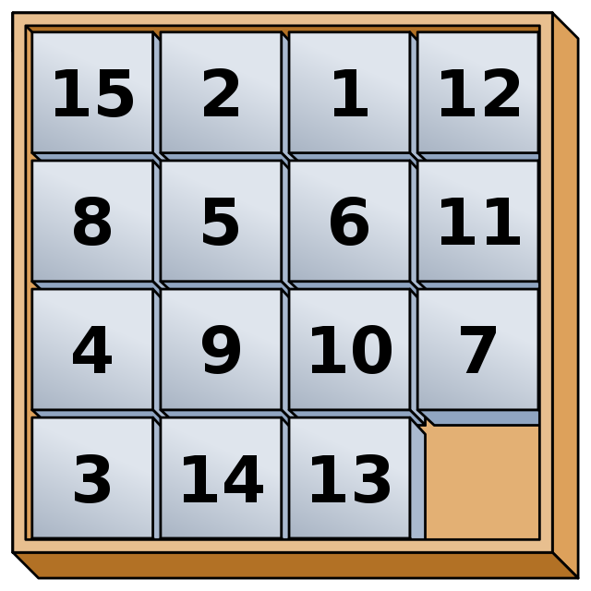
Slider 15 Puzzle
https://en.wikipedia.org/wiki/15_puzzle

Slide 4
SliderPlus Puzzle
In similar lines, we will be doing “SliderPlus” puzzle towards A3, A4 and A5.
What is special about “SliderPlus”?
It doesn’t care about numbers. It handles the characters, Strings, Sub-Strings (A, B, C…. O)
It basically splits a given string into 15 chunks, randomizes those chunks and places those chunks in the board.
It also handles “multi-byte” characters (characters that occupy more than 1 byte; Unicode characters).
Playing the puzzle is out of scope. We are only generating the puzzle
Graphical User Interface (GUI) is also out of scope. We will generate a Power Point (so, java to Power Point integration is required)

Slide 5
SliderPlus: A3, A4 and A5 Goals
A “quotes.csv” file contains a set of quotes.
Each line in the CSV file contains two fields.
id, quote
Our “SliderPlus” program
reads the “quotes.csv”
splits each quote into 15 equal chunks.
relies on web services to split the string into chunks
places them in the grid
generates a power point.

Slide 6
SliderPlus: Implementation Guidance
You can use JAVA or PYTHON as your programming language.
Both programming languages have excellent support for Power Point integration.
Java can be verbose.
Python is elegant.
If you know only Python, do it in Python.
If you can do it in either, do it in Python.
If you only know Java, do it in Java.
If you want to challenge yourself, do A2, A3 and A4 in the language you have not touched before.

Slide 7
SliderPlus: Implementation Guidance
Following slides provide some sample puzzles generated by our “SliderPlus” program

Slide 8

Slider Plus # 1
I | G | K | H
A | L | C | D
J | B | N | O
F | E | M

Slide 9
Slider Plus # 2
I | G | K | H
A | L | C | D
J | B | NO | PQ
F | E | M

Slide 10
Slider Plus # 3
అ | ఇ | ఈ | ఉ
ఊ | ఆ | ఒ | అ:
ఎ | ఓ | ఔ | క
ఏ | ఐ | అం

Slide 11
Slider Plus # 4 (TBD)

Slide 12
Suggested Plan of attack
(You have the opportunity to catch up)
Assignment | Scope
A3 (Jan 26) | Hardcode the input String Call the web service to get logical characters Group the string into 15 chunks Generate the puzzle in text format Explore Power Point Integration
A4 (Feb 2) | Read the quotes from quotes.csv file Do mass generation of the puzzles Create/generate the Power Point slides
A5 (Feb 9) | Configuration (color, font, background, language) Bug Fixing Addressing any feedback I give during A3 and A4. All should be done by Feb 9. Demos every week in 1:1 breakout room. Final demo/review/evaluation on Feb 9.

